Slide 1
STANDARD SCALAR
The idea behind StandardScaler is that it will transform your data such that its distribution will have a mean value 0 and standard deviation of 1.
In case of multivariate data, this is done feature-wise (in other words independently for each column of the data).

Slide 2
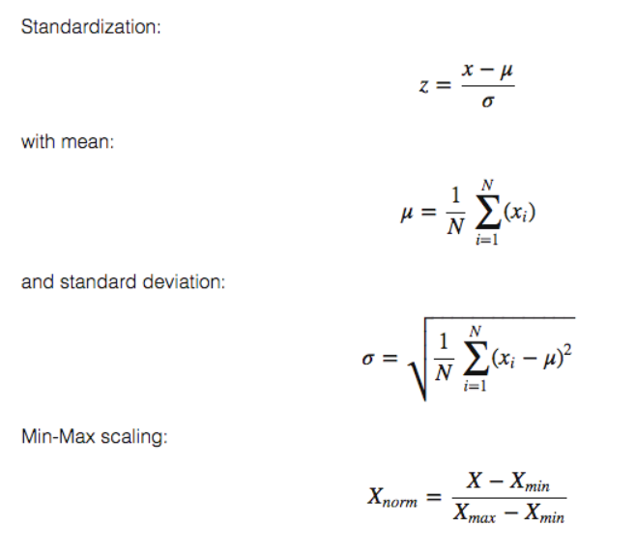

Slide 3
# calculate column means
def column_means(dataset):
means = [0 for i in range(len(dataset[0]))]
for i in range(len(dataset[0])):
col_values = [row[i] for row in dataset]
means[i] = sum(col_values) / float(len(dataset))
return means
# calculate column standard deviations
def column_stdevs(dataset, means):
stdevs = [0 for i in range(len(dataset[0]))]
for i in range(len(dataset[0])):
variance = [pow(row[i]-means[i], 2) for row in dataset]
stdevs[i] = sum(variance)
stdevs = [sqrt(x/(float(len(dataset)-1))) for x in stdevs]
return stdevs
# standardize dataset
def standardize_dataset(dataset, means, stdevs):
for row in dataset:
for i in range(len(row)):
row[i] = (row[i] - means[i]) / stdevs[i]

Slide 4
PCA (Principal Component Analysis)
Principal Component Analysis, or PCA, is a dimensionality-reduction method that is often used to reduce the dimensionality of large data sets, by transforming a large set of variables into a smaller one that still contains most of the information in the large set.
Reducing the number of variables of a data set naturally comes at the expense of accuracy, but the trick in dimensionality reduction is to trade a little accuracy for simplicity.
Because smaller data sets are easier to explore and visualize and make analyzing data much easier and faster for machine learning algorithms without extraneous variables to process.
So to sum up, the idea of PCA is simple — reduce the number of variables of a data set, while preserving as much information as possible.

Slide 5
Steps in PCA:
1. Subtract the mean of each variable
2. Calculate the Covariance Matrix
3. Compute the Eigenvalues and Eigenvectors
4. Sort Eigenvalues in descending order
5. Select a subset from the rearranged Eigenvalue matrix
6. Transform the data

Slide 6
import numpy as np
def PCA(X , num_components):
#Step-1
X_meaned = X - np.mean(X , axis = 0)
#Step-2
cov_mat = np.cov(X_meaned , rowvar = False)
#Step-3
eigen_values , eigen_vectors = np.linalg.eigh(cov_mat)
#Step-4
sorted_index = np.argsort(eigen_values)[::-1]
sorted_eigenvalue = eigen_values[sorted_index]
sorted_eigenvectors = eigen_vectors[:,sorted_index]
#Step-5
eigenvector_subset = sorted_eigenvectors[:,0:num_components]
#Step-6
X_reduced = np.dot(eigenvector_subset.transpose() , X_meaned.transpose() ).transpose()
return X_reduced

Slide 8
String Components which needed to be pre-processed:
protocol_types = []
services = []
flags = []
for i in range (494020):
if(data['service'][i] not in services):
services.append(data['service'][i])
if(data['protocol_type'][i] not in protocol_types):
protocol_types.append(data['protocol_type'][i])
if(data['flag'][i] not in flags):
flags.append(data['flag'][i])
print(protocol_types)
print(services)
print(flags)
protocol_type = []
service = []
flag = []

Slide 9
for i in range (494020):
protocol_type.append(protocol_types.index(data['protocol_type'][i]))
service.append(services.index(data['service'][i]))
flag.append(flags.index(data['flag'][i]))
del data['protocol_type']
del data['service']
del data['flag']
data['protocol_type'] = protocol_type
data['service'] = service
data['flag'] = flag

Slide 10
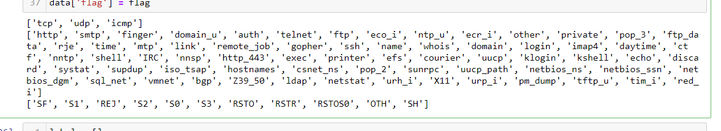

Slide 11
Standard Scalar :
# applying standard scalar
sc = StandardScaler()
X_train = sc.fit_transform(X_train)
X_test = sc.transform(X_test)
X_train = DataFrame(X_train)
X_test = DataFrame(X_test)

Slide 12
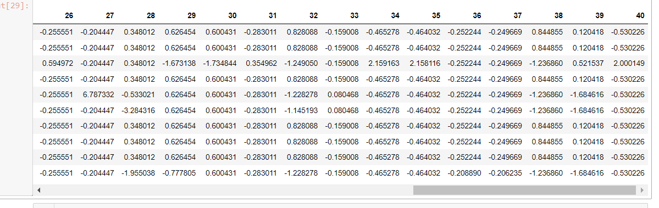

Slide 13
PCA:
scaler = StandardScaler()
data_rescaled = scaler.fit_transform(data)
pca = PCA().fit(data_rescaled)
%matplotlib inline
plt.rcParams["figure.figsize"] = (12,6)
fig, ax = plt.subplots()
xi = np.arange(1, 42, step=1)
y = np.cumsum(pca.explained_variance_ratio_)

Slide 14
plt.ylim(0.0,1.1)
plt.plot(xi, y, marker='o', linestyle='--', color='b')
plt.xlabel('Number of Components')
plt.xticks(np.arange(0, 42, step=1)) #change from 0-based array index to 1-based human-readable label
plt.ylabel('Cumulative variance (%)')
plt.title('The number of components needed to explain variance')
plt.axhline(y=0.95, color='r', linestyle='-')
plt.text(0.5, 0.85, '95% cut-off threshold', color = 'red', fontsize=16)
ax.grid(axis='x')
plt.show()

Slide 15
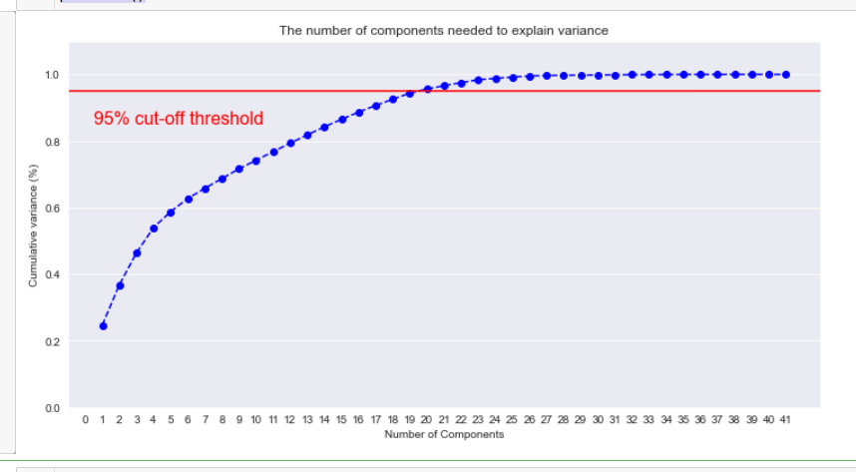

Slide 16
#95% of variance
from sklearn.decomposition import PCA
pca = PCA(n_components = 21)
pca.fit(X_train)
reduced = pca.transform(X_train)

Slide 17
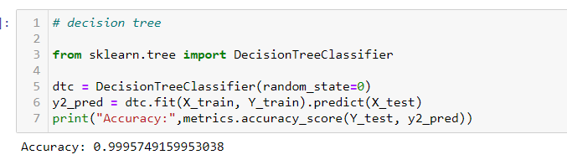

Slide 18
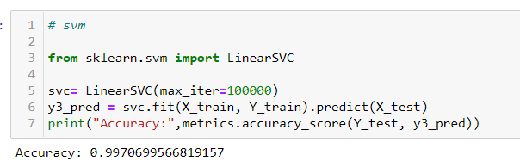

Slide 19
K-Means Clustering:
# k-means clustering
import numpy as np
import pandas as pd
import matplotlib.pyplot as plt
from sklearn.cluster import KMeans
kmeans = KMeans(n_clusters=21)
y_kmeans = kmeans.fit_predict(data)
print(y_kmeans)
kmeans.cluster_centers_

Slide 20
Error =[]
for i in range(1, 11):
kmeans = KMeans(n_clusters = i).fit(data)
kmeans.fit(data)
Error.append(kmeans.inertia_)
import matplotlib.pyplot as plt
plt.plot(range(1, 11), Error)
plt.title('Elbow method')
plt.xlabel('No of clusters')
plt.ylabel('Error')
plt.show()

Slide 21
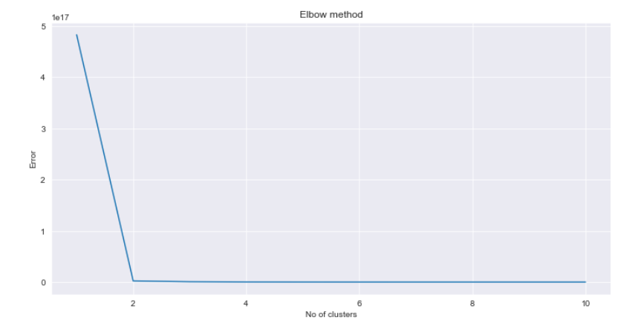

Slide 22
# k-means clustering
import numpy as np
import pandas as pd
import matplotlib.pyplot as plt
from sklearn.cluster import KMeans
kmeans = KMeans(n_clusters=2)
y_kmeans = kmeans.fit_predict(X_train)
print(y_kmeans)
kmeans.cluster_centers_

Slide 23
Fully Connected Neural Network:
import tensorflow as tf
from tensorflow.keras import backend as K
model=Sequential()
model.add(Dense(100,input_dim=41,activation='relu'))
model.add(Dense(50,activation='relu'))
model.add(Dense(30,activation='relu'))
model.add(Dropout(0.2))
model.add(Dense(1,activation='softmax'))
model.compile(loss='categorical_crossentropy',optimizer='adam',metrics=['accuracy'])

Slide 24
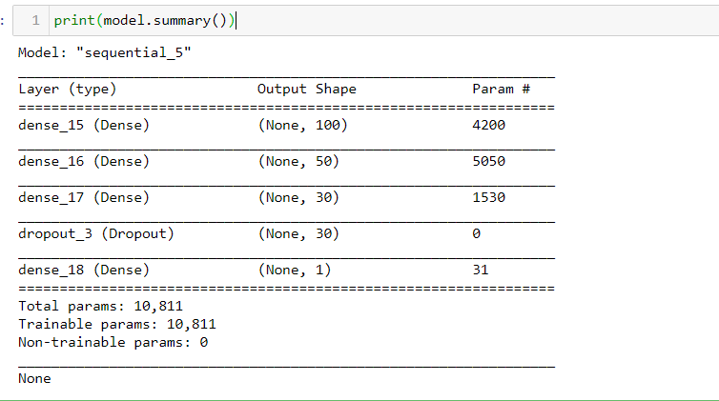

Slide 25
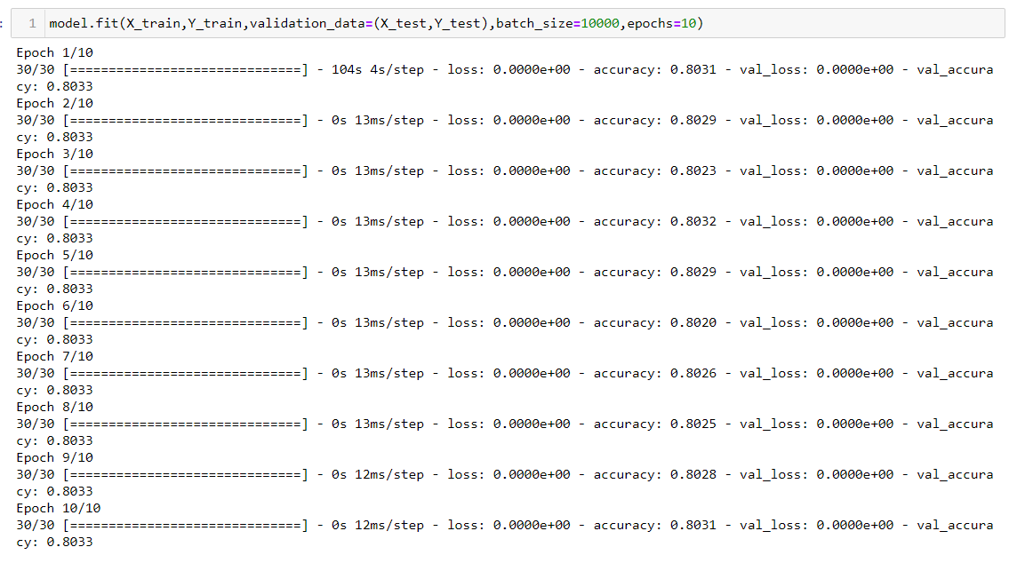

Slide 26
Confusion Matrix:
# GAUSSIAN NAIVE BAYES
print("Confusion Matrix for Naive Bayes")
cm = confusion_matrix(Y_test, y1_pred)
print(cm)
# DECISION TREE
print("Confusion Matrix for Decision Tree")
cm = confusion_matrix(Y_test, y2_pred)
print(cm)
# SVM
print("Confusion Matrix for SVM")
cm = confusion_matrix(Y_test, y3_pred)
print(cm)

Slide 27
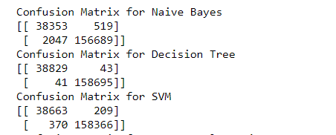

Slide 28
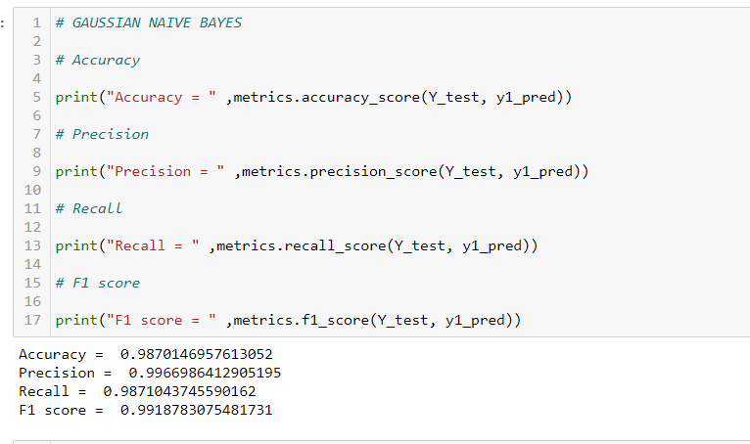

Slide 29
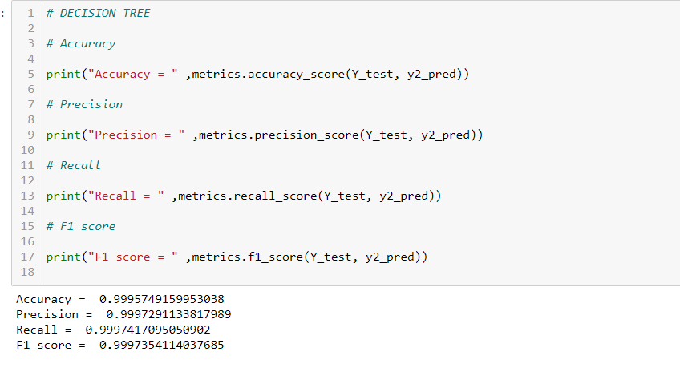

Slide 30
